Slide 1

KNOWLEDGE INSTITUTE OF TECHNOLOGY, SALEM – 637504
(Autonomous Institution)
MAP
2025
First Review
Power Weeder for Coconut Farm
Batch No.: 02
Club Name: SMART AUTOMATION CLUB
Team Members: B. Dharaneshwaran, A. Harish, R. Dharaneesh, R. Gokilnathan
Full Affiliation: III Year MECH, Knowledge Institute of Technology. Salem.
Name of the Mentor: Prof K.N. Karthick
Presentation Date: 18.09.2025

Slide 2
Table of Content
List of Problems through customers / industry defined problems/contest etc.
Selected Final Problem Statement (with KIOT faculty mentor)
Discussion with customer
Key assumptions and objective
Plan to execute
References if any

Slide 3
List of Problems through customers / industry defined problems/contest etc.
 | Short Summary of Problem Statement | Problem identified through (direct customer, industry, SIH contest, other contest etc.) | Align with SDGs (SDG 1 to SDG17)
Problem Statement 1 | High labour cost in coconut basin weeding | Direct Customer (Farmers) | SDG 2
Problem Statement 2 | Root damage from heavy brush cutters | Agricultural Industry | SDG 9
Problem Statement 3 | Labour shortage in agriculture | SIH 2024 / Govt Reports | SDG 1
Problem Statement 4 | High fuel & maintenance cost | Agri Innovation Contest | SDG 7
Problem Statement 5 | No lightweight root-safe weeder | Customer Feedback | SDG 15

Slide 4
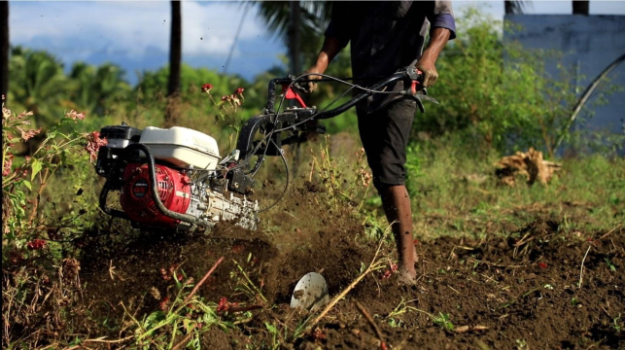
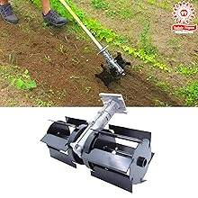
Discussion with Customer

Slide 5
Selected Final Problem Statement
This project is about designing a power weeder for coconut farms. It helps remove weeds quickly and easily between coconut trees. The machine reduces manual work, saves time and labor cost, and improves farm productivity. It is simple, efficient, and suitable for small and medium farmers.…

Slide 6
Key assumptions and Objective
Key Assumptions
Coconut farms have narrow spacing between trees.
Farmers need a low-cost and easy-to-operate machine.
The soil condition may be uneven and semi-wet.
The machine should not damage coconut tree roots.
Maintenance facilities in rural areas are limited.
Objectives
To design a compact power weeder suitable for coconut farms.
To reduce manual labor and time required for weeding.
To improve operational efficiency and productivity.
To ensure safe operation around coconut trees.
To develop a cost-effective and durable machine.

Slide 7
Plan to Execute
Problem Study
⬇
Requirement Analysis
⬇
Concept Design
⬇
CAD Modelling
⬇
Design Validation
⬇
Prototype Planning
⬇
Final Documentation

Slide 8
References
https://www.ijert.org/design-and-fabrication-of-pedal-operated-flour-mill
https://doi.org/10.1016/j.jfoodeng.2008.07.021
https://www.researchgate.net/publication/327259782_Design_and_Development_of_Multi_Grain_Grinding_Machine
https://www.ijstr.org/final-print/sep2019/Design-And-Fabrication-Of-Pedal-Operated-Multi-Purpose-Machine.pdf
https://doi.org/10.1007/s13197-011-0456-2
https://www.sciencedirect.com/science/article/pii/S0260877403000415

